Slide 1
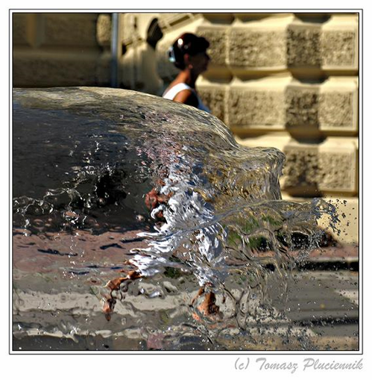
The Camera
CS180: Intro to Comp. Vision, and Comp. Photo
Alexei Efros, UC Berkeley, Fall 2024

Slide 2


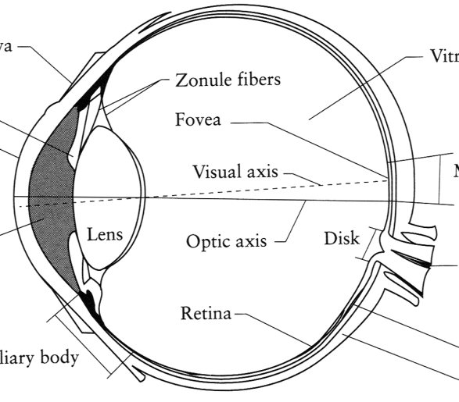
Image Formation
Digital Camera
Film
The Eye

Slide 3
How do we see the world?
Let’s design a camera
Idea 1: put a piece of film in front of an object
Do we get a reasonable image?
Slide by Steve Seitz

Slide 4
Pinhole camera
Add a barrier to block off most of the rays
This reduces blurring
The opening known as the aperture
How does this transform the image?
Slide by Steve Seitz
Notes:
It gets inverted

Slide 5
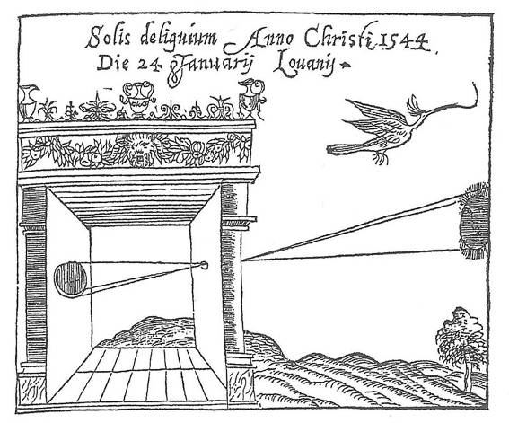
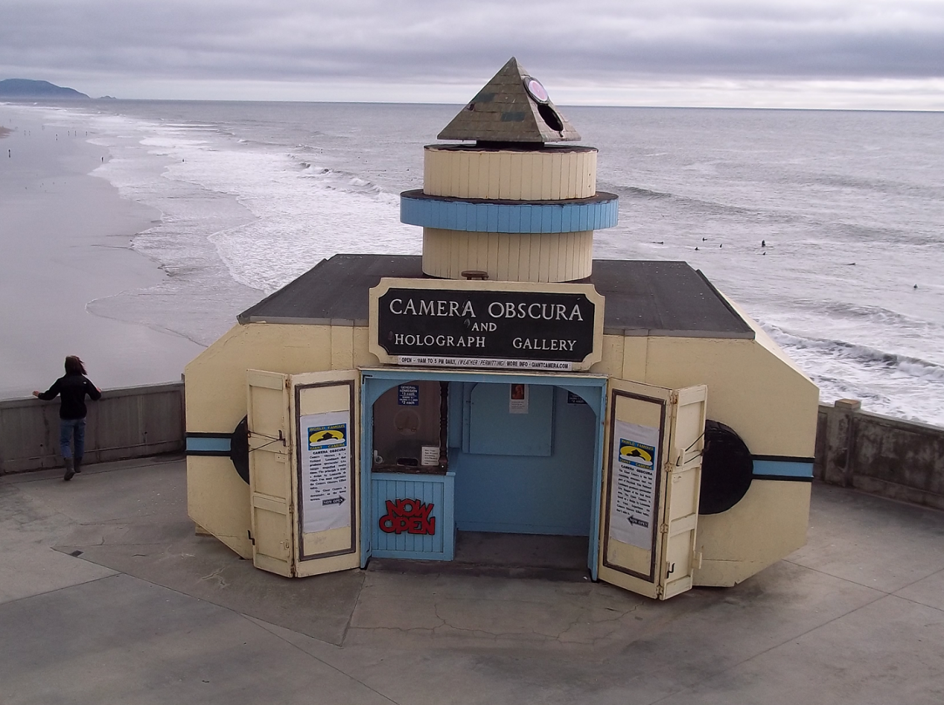
Camera Obscura: the pre-camera
First Idea: Mo-Ti, China (470-390 BC)
First build: Al Hacen, Iraq/Egypt (965-1039 AD)
Drawing aid for artists: described by Leonardo da Vinci (1452-1519)
Gemma Frisius, 1558
Camera Obscura near Cliff House

Slide 6
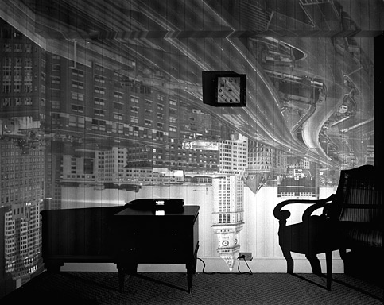
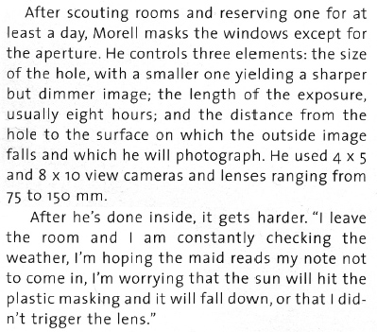
8-hour exposure (Abelardo Morell)
http://www.abelardomorell.net/books/books_m02.html
From Grand Images Through a Tiny Opening, Photo District News, February 2005

Slide 7
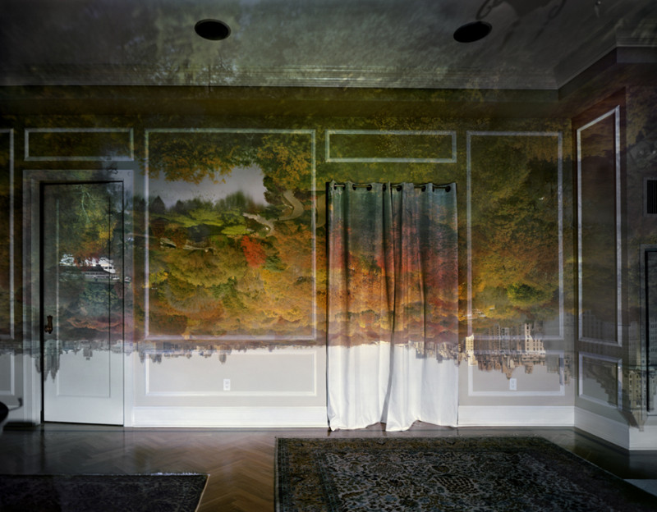

Slide 8
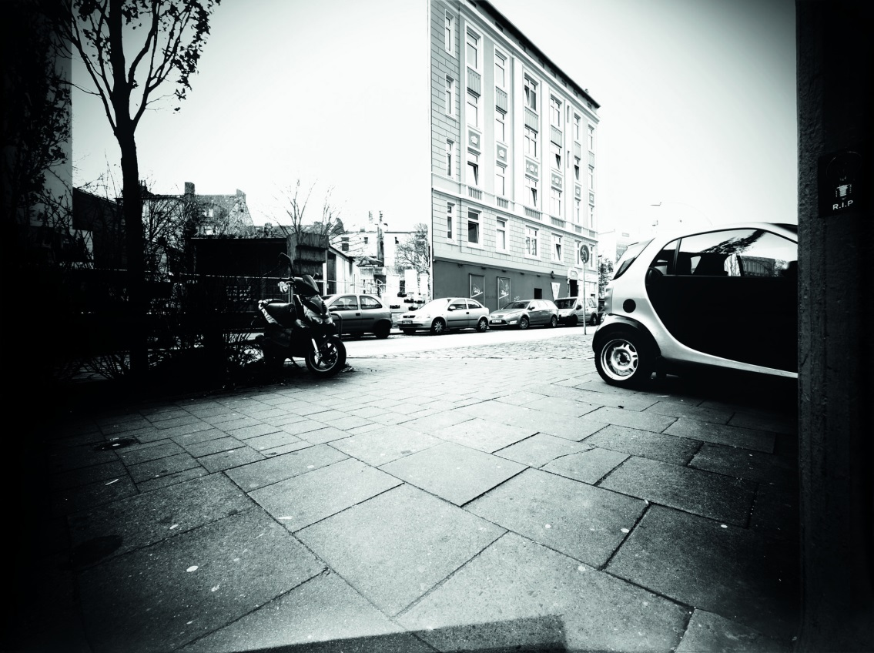

“Trashcam” Project
http://petapixel.com/2012/04/18/german-garbage-men-turn-dumpsters-into-giant-pinhole-cameras/

Slide 9
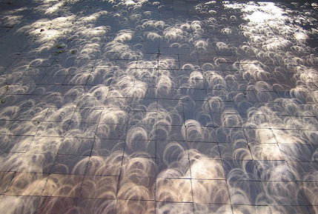
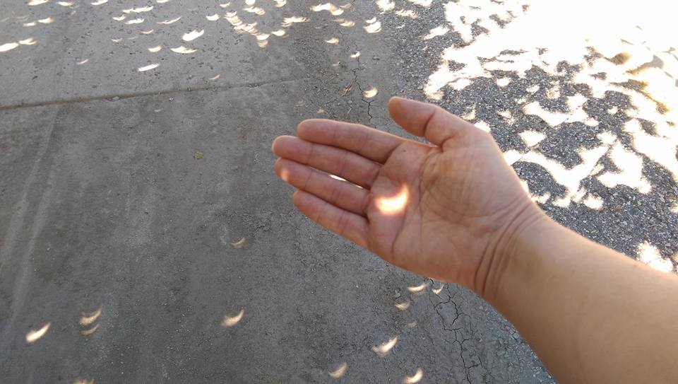
Pinhole cameras everywhere
Tree shadow during a solar eclipse
photo credit: Nils van der Burg http://www.physicstogo.org/index.cfm
© Trina Singley
Slide by Steve Seitz

Slide 10
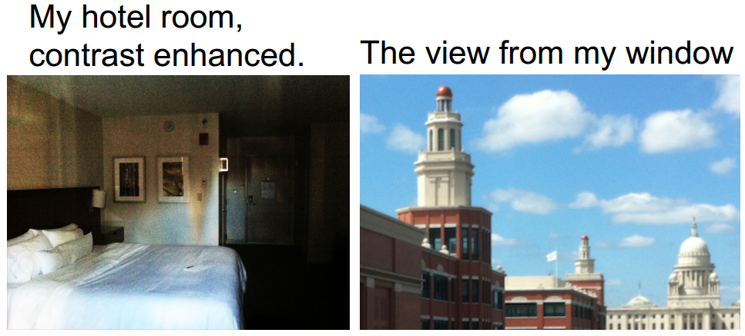
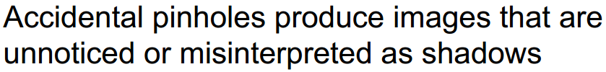
Accidental pinhole cameras
A. Torralba and W. Freeman, Accidental Pinhole and Pinspeck Cameras, CVPR 2012

Slide 11
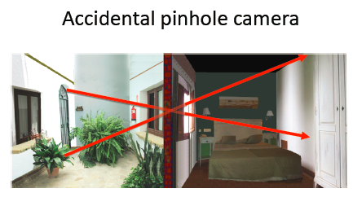
Torralba and Freeman, CVPR’12

Slide 12
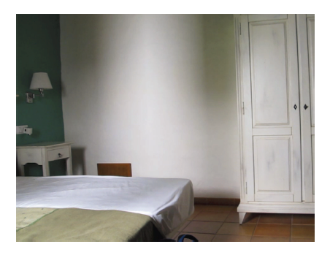

Slide 13
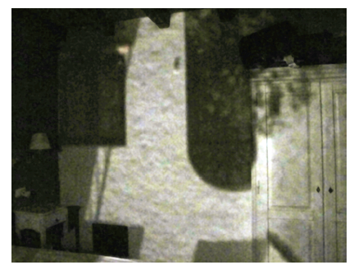

Slide 14
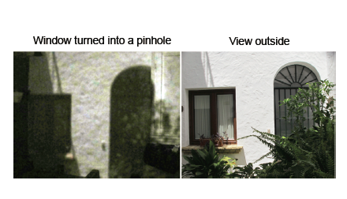

Slide 15
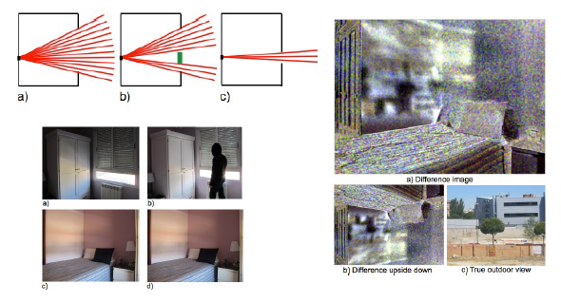
Pinspeck Camera: the anti-pinhole

Slide 16
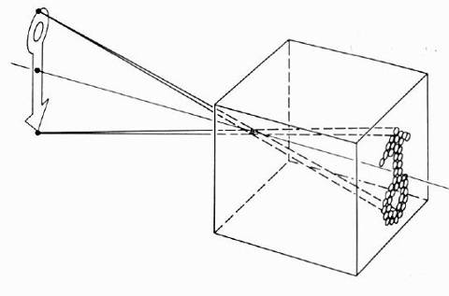
Pinhole camera model
Pinhole model:
Captures pencil of rays – all rays through a single point
The point is called Center of Projection (COP)
The image is formed on the Image Plane
Effective focal length d is distance from COP to Image Plane
Slide by Steve Seitz

Slide 17
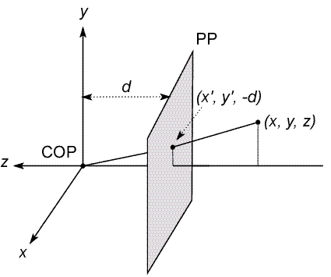
Modeling projection
The coordinate system
We will use the pin-hole model as an approximation
Put the optical center (Center Of Projection) at the origin
Put the image plane (Projection Plane) in front of the COP
Why?
The camera looks down the negative z axis
we need this if we want right-handed-coordinates
Slide by Steve Seitz
Notes:
This way the image is right-side-up

Slide 18
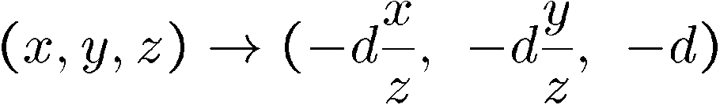
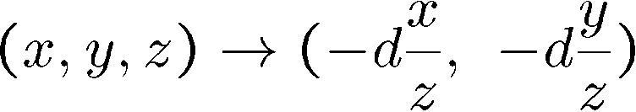
Modeling projection
Projection equations
Compute intersection with PP of ray from (x,y,z) to COP
Derived using similar triangles (on board)
We get the projection by throwing out the last coordinate:
Slide by Steve Seitz

Slide 19
Dimensionality Reduction Machine (3D to 2D)
3D world
2D image
But there is a problem…
Figures © Stephen E. Palmer, 2002

Slide 20
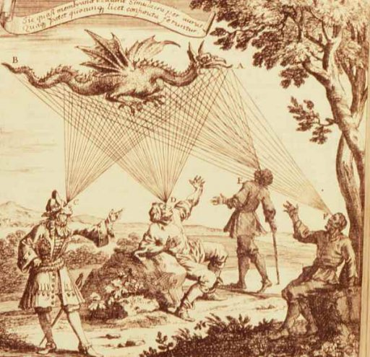

Emission Theory of Vision
“For every complex problem there is an answer that is clear, simple, and wrong.”
-- H. L. Mencken
Supported by:
Empedocles
Plato
Euclid (kinda)
Ptolemy
…
50% of US college students*
*http://www.ncbi.nlm.nih.gov/pubmed/12094435?dopt=Abstract
Eyes send out “feeling rays” into the world

Slide 21
How we see the world
3D world
2D image
Figures © Stephen E. Palmer, 2002

Slide 22
How we see the world
3D world
2D image
Painted
backdrop

Slide 23
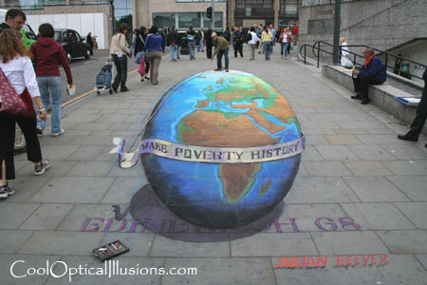
Fooling the eye

Slide 24
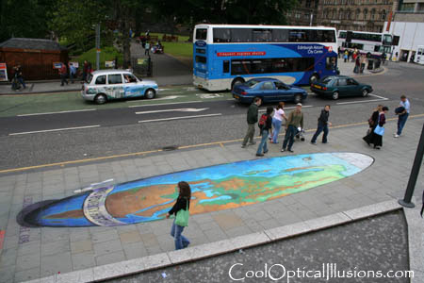
Fooling the eye
Making of 3D sidewalk art: http://www.youtube.com/watch?v=3SNYtd0Ayt0

Slide 25
Dimensionality Reduction Machine (3D to 2D)
3D world
2D image
Why did evolution opt for such strange solution?
Nice to have a passive, long-range sensor
Can get 3D with stereo or by moving around, plus experience

Slide 26
Dimensionality Reduction Machine (3D to 2D)
3D world
2D image
What have we lost?
Angles
Distances (lengths)
Figures © Stephen E. Palmer, 2002

Slide 27
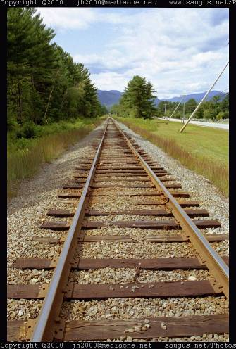
Funny things happen…

Slide 28
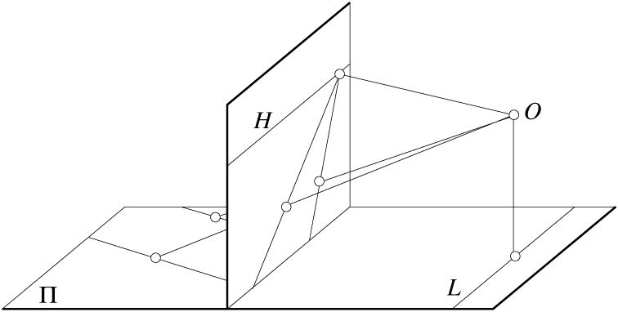
Parallel lines aren’t…
Figure by David Forsyth

Slide 29
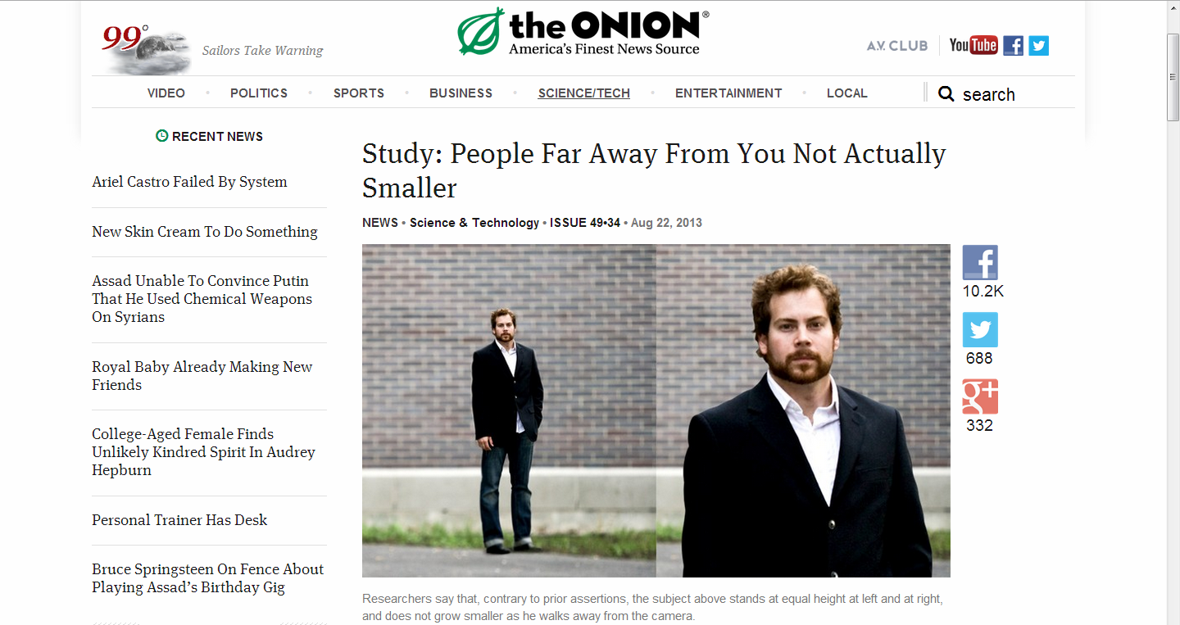
Exciting New Study!

Slide 30
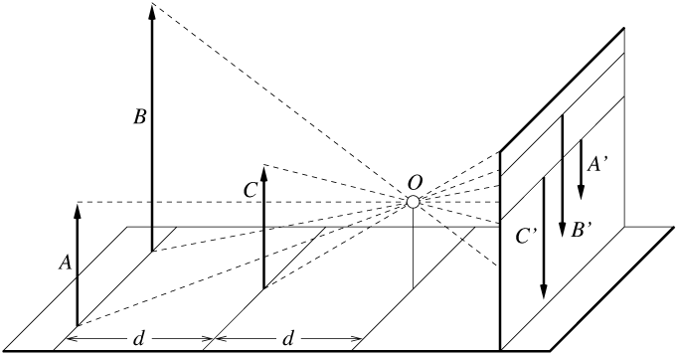
Lengths can’t be trusted...
A’
C’
B’
Figure by David Forsyth

Slide 31
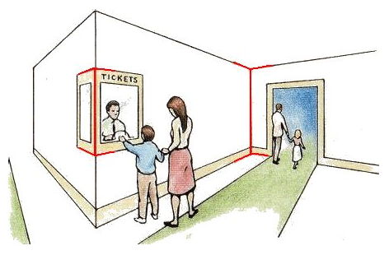
…but humans adopt!
Müller-Lyer Illusion
We don’t make measurements in the image plane
http://www.michaelbach.de/ot/sze_muelue/index.html

Slide 32
Other projections: Orthographic
Special case of perspective projection
Distance from the COP to the PP is infinite
Also called “parallel projection”
x’ = x
y’ = y
Image
World
Slide by Steve Seitz

Slide 33
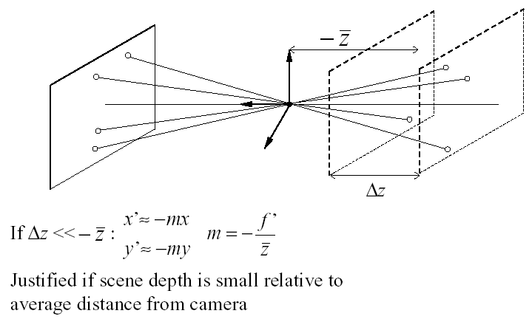
Scaled Orthographic or “Weak Perspective”

Slide 34
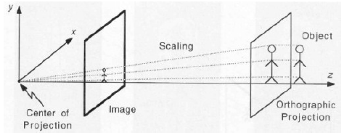
Scaled Orthographic or “Weak Perspective”

Slide 35
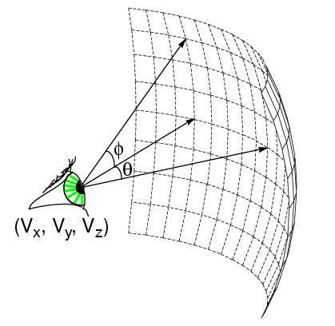
Spherical Projection
What if PP is spherical with center at COP?
In spherical coordinates, projection is trivial:
(θ,φ) = (θ,φ,d)
Note: doesn’t depend on focal length f!

Slide 36
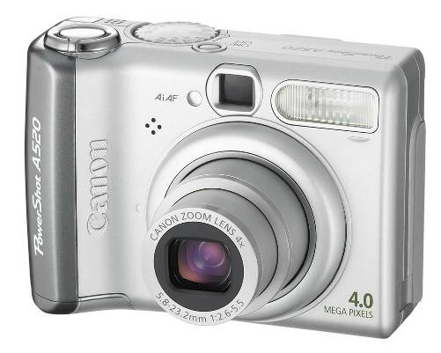
Building a real camera

Slide 37
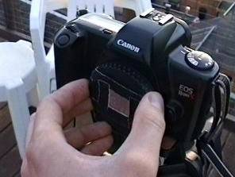
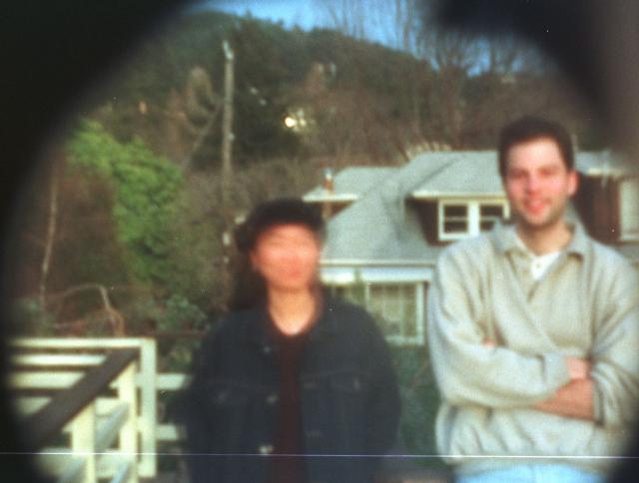
Another way to make pinhole camera
Why so
blurry?
http://www.debevec.org/Pinhole/

Slide 38
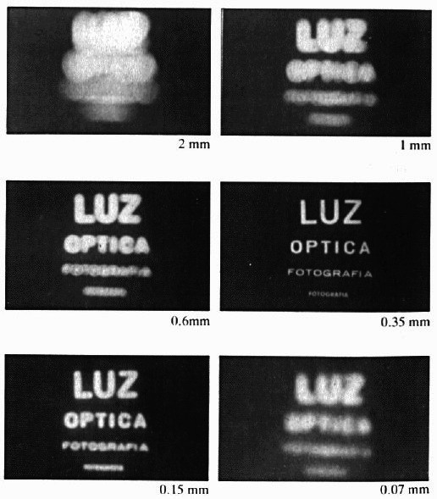
Shrinking the aperture
Less light gets through
Why not make the aperture as small as possible?
Less light gets through
Diffraction effects…
Slide by Steve Seitz

Slide 39
Shrinking the aperture

Slide 40
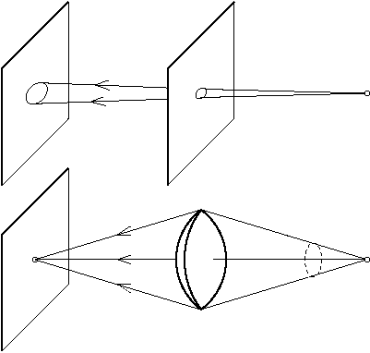
The reason for lenses
Slide by Steve Seitz

Slide 41
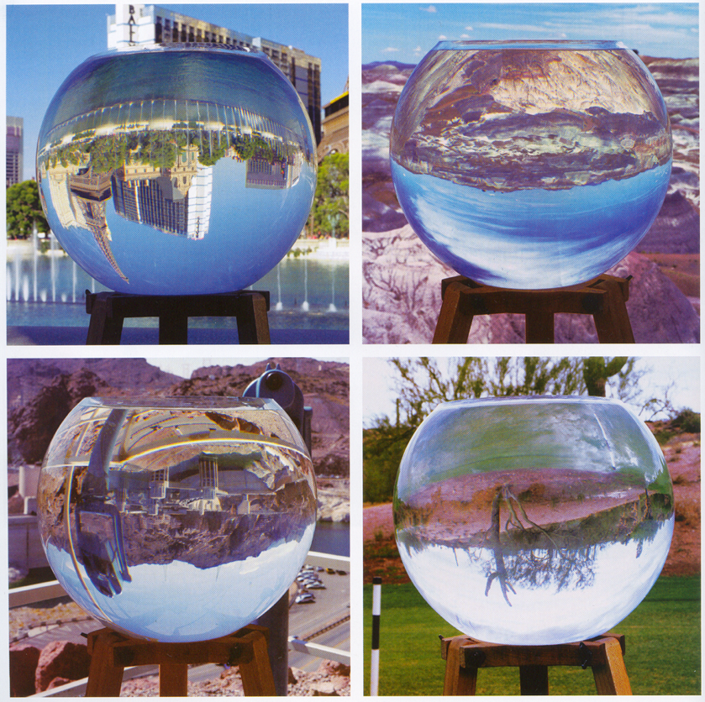
Replacing pinholes with lenses
Photography,
London et al

Slide 42
Focus

Slide 43
Focus and Defocus
“circle of
confusion”
A lens focuses light onto the film
There is a specific distance at which objects are “in focus”
other points project to a “circle of confusion” in the image
Changing the shape of the lens changes this distance
Slide by Steve Seitz

Slide 44
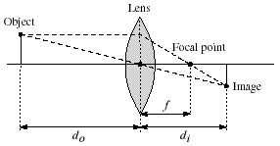
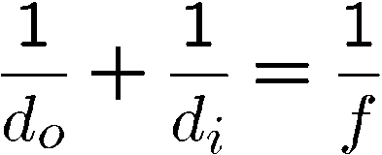
Thin lenses
Thin lens equation:
Any object point satisfying this equation is in focus
What is the shape of the focus region?
Thin lens applet: http://www.phy.ntnu.edu.tw/java/Lens/lens_e.html (by Fu-Kwun Hwang )
Slide by Steve Seitz
Notes:
focal point is where all the rays meet through the lens, the distance bwetetn the focal point and the lens is the focal length with lenses.

Slide 45
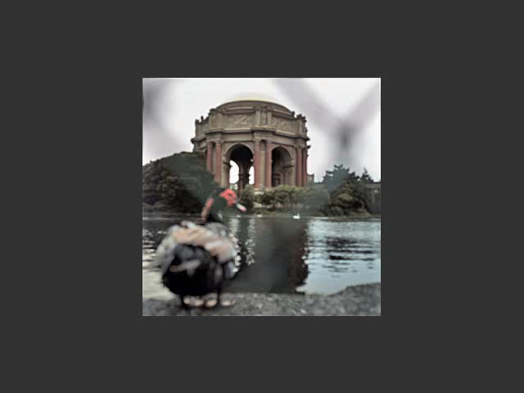
Varying Focus
Ren Ng

Slide 46
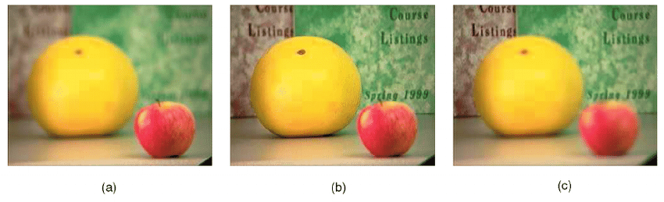
Varying Focus

Slide 47
Depth Of Field

Slide 48
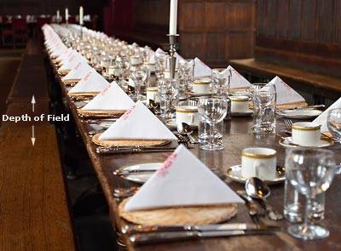
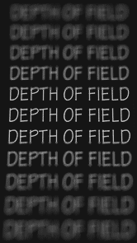
Depth of Field
http://www.cambridgeincolour.com/tutorials/depth-of-field.htm
Notes:
DoF = regions that look like are in focus (not a single plane)

Slide 49
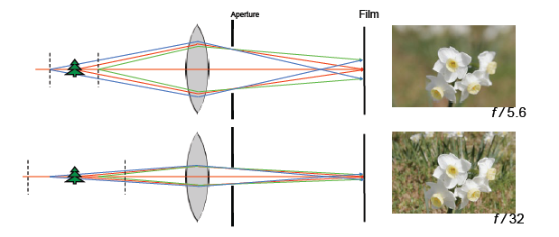
Aperture controls Depth of Field
Changing the aperture size affects depth of field
A smaller aperture increases the range in which the object is approximately in focus
But small aperture reduces amount of light – need to increase exposure
Notes:
phone cameras all have cheap lens and small aperture (everything is kind of in focus, expensive cameras give you stuf like above)

Slide 50
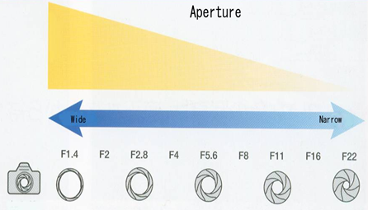
F-number: focal length / aperture diameter

Slide 51
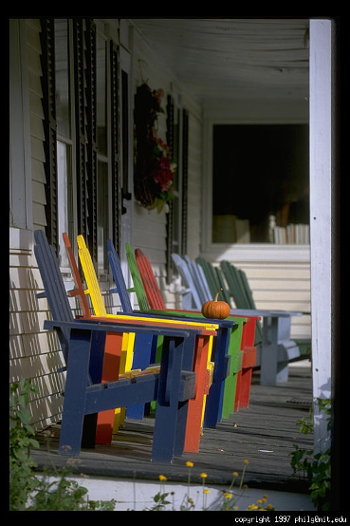
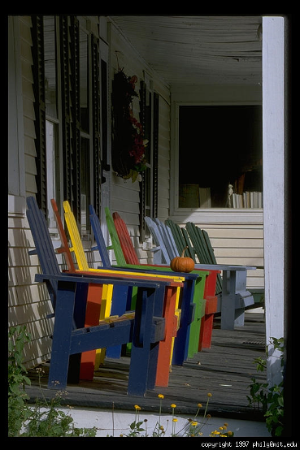
Varying the aperture
Wide apeture = small DOF
Narrow apeture = large DOF

Slide 52

Nice Depth of Field effect

Slide 53
Field of View (Zoom)

Slide 54
Field of View (Zoom)

Slide 55
Field of View (Zoom) = Cropping

Slide 56
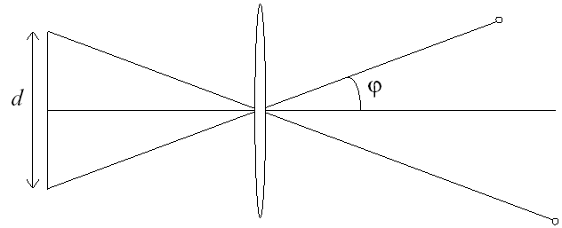
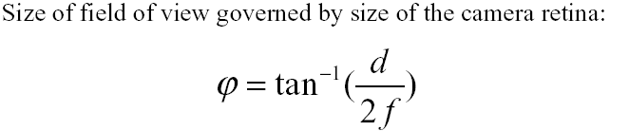
FOV depends of Focal Length
f
f
Smaller FOV = larger Focal Length

Slide 57

Expensive toys…

Slide 58


Field of View / Focal Length
Large FOV / small f
+ Camera close to car
Small FOV / large f
+ Camera far from the car
Notes:
IS the left Wider FOV or Narrow? FOV is just zoom (cropping), but this effect is two things happening at the same time, you move back (these images don’t share the same center of projection)

Slide 59

From Zisserman & Hartley

Slide 60

Focal length / distance in portraiture
Notes:
exaggerated perspective effects on the nose, step back and zoom in.

Slide 61

Dolly Zoom (“Vertigo Shot”)
http://filmmakermagazine.com/83872-hitchcock-to-scorcese-47-years-of-the-dolly-zoom/#.VBNtn_ldVac

Slide 62
Exposure

Slide 63

Shutter Speed
http://en.wikipedia.org/wiki/Shutter_speed
Notes:
Blur in time

Slide 64

Exposure: shutter speed vs. aperture
Notes:
why pick one over the other? When is the right preferable over the other? wide DoF which one do you want? (A: smaller aperture), if things are moving, then you open it up and won’t need to wait as much

Slide 65

Notes:
very long apertureso much that the earth moved (1hr~)

Slide 66


Fun with slow shutter speeds
Photos by Fredo Durand

Slide 67

More fun
http://vimeo.com/14958082

Slide 68
Lens Flaws

Slide 69

Lens Flaws: Chromatic Aberration
Dispersion: wavelength-dependent refractive index
(enables prism to spread white light beam into rainbow)
Modifies ray-bending and lens focal length: f(λ)
color fringes near edges of image
Corrections: add ‘doublet’ lens of flint glass, etc.

Slide 70




Chromatic Aberration
Slide by Carl Doersch

Slide 71


Chromatic Aberration
Near Lens Center
Near Lens Outer Edge

Slide 72

Radial Distortion (e.g. ‘Barrel’ and ‘pin-cushion’)
straight lines curve around the image center

Slide 73

Radial Distortion
No distortion
Pin cushion
Barrel
Radial distortion of the image
Caused by imperfect lenses
Deviations are most noticeable for rays that pass through the edge of the lens

Slide 74



Radial Distortion

